Slide 1
Arterial Spin Labeling
Irene Vavasour
Mar 6, 2024
UBC MRI Research Monthly Analysis Meeting

Slide 2
References
P Clement, J Petr, MBJ Dijsselhof, et al. A Beginner’s Guide to Arterial Spin Labeling (ASL) Image Processing. Frontiers in Radiology. 2022;2:929533.
L Hernandez-Garcia, A Lahiri, J Schollenberger. Recent Progress in ASL. Neuroimage 2019;187:3-16.
Alsop DC, Detre JA, Golay X, et al. Recommended implementation of arterial spin-labeled perfusion MRI for clinical applications: A consensus of the ISMRM perfusion study group and the European consortium for ASL in dementia. Magn Reson Med 2015;73(1):102–116.
ASL resources prepared by OSIPI (ISMRM ASL Study Group) can be found at https://osipi.github.io/

Slide 3
What is Arterial Spin Labeling (ASL)
MRI technique for brain perfusion measurements
Advantages over more widely used dynamic-susceptibility contrast (DSC) MRI or PET
no exogenous contrast agent
avoids side effects
cheaper
immediately repeatable
labeled water not confined to intravascular spaces

Slide 4
Cerebral Blood Flow
Cerebral blood flow (CBF) is dependent on
heart rate
blood pressure
blood volume
blood composition
hematocrit
vessel anatomy
oxygen metabolism (neurovascular coupling)
In young healthy adults, CBF values:
cortical grey matter = ~50-70mL/100g/min
white matter = ~20mL/100g/min

Slide 5
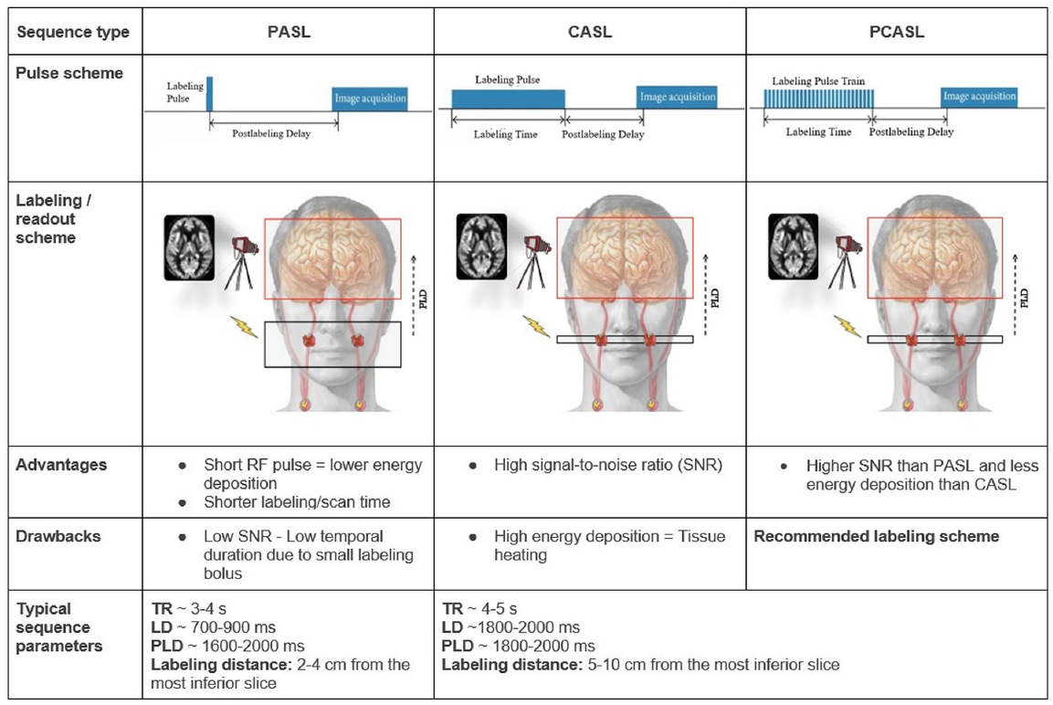
ASL Acquisition
Acquisition
- a control and labeled image are subtracted
M0 image
- perfusion calibration image acquired for quantification
Post-Labeling Delay (PLD)
- allows blood to flow into vessels and capillaries
Labeling
-inflowing blood magnetisation is inverted
Structural Image
- allows ROI analysis

Slide 6
ASL Acquisition
partition coefficient
6000*λ*(S_{control}-S_{label})*e^{PLD/T1,blood}
CBF =
2*α*T_{1,blood}S_{PD}*(1-e^{-t/T1,blood})
efficiency of labeling
T Iutaka. RadioGraphics 2023

Slide 7
ASL Acquisition
Difference between control and labeled signal is ~1-2% so need averaging
Can also do background suppression
extra RF pulse between labeling and acquisition to reduce tissue signal
Helps reduce the effect of head motion
Newer acquisition protocols collect data at several PLDs
provides temporal dynamics
more accurate CBF measurement

Slide 8
ASL Acquisition
Also have Velocity-selective ASL
inverts spins based on blood velocity, by saturating blood moving faster than predetermined rate
good for slow flow such as in stroke
P Clement Frontiers in Radiology 2022

Slide 9
ASL signal
Affected by
labeling efficiency
T1 relaxation in arterial blood
blood transport time through vessels and tissue
magnetisation transfer effects

Slide 10
Use of ASL
T Iutaka. RadioGraphics 2023

Slide 11
Limitations
Perfusion alterations are small
not visible in individuals
Can only detect perfusion differences at a group level
Longer acquisition time means more susceptible to motion

Slide 12
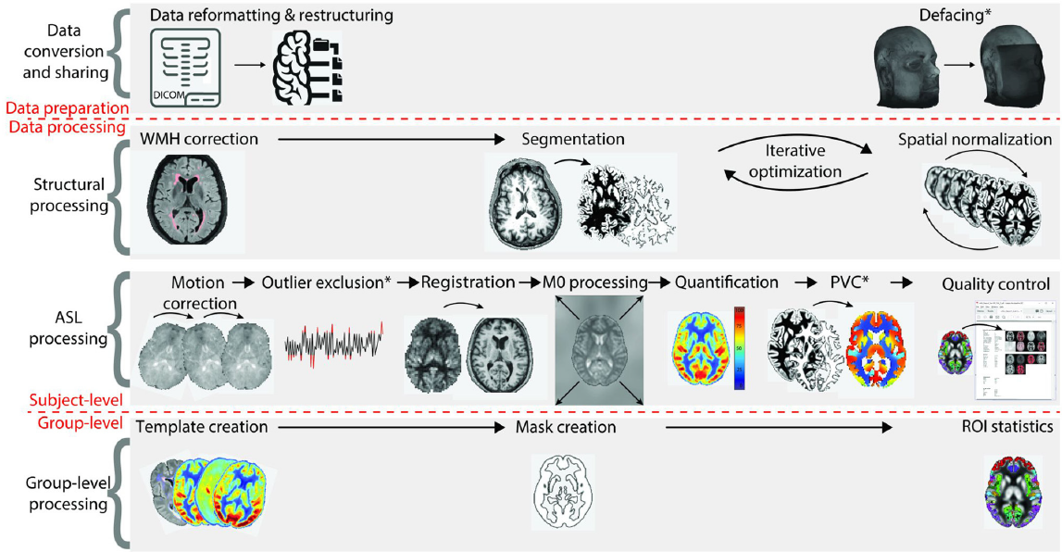
Processing Steps
P Clement Frontiers in Radiology 2022

Slide 13
Data Conversion and Sharing
Many software pipelines use NIfTI format
Having data in BIDS format also helpful
ASL-BIDS extension

Slide 14
Structural Processing
Lesion Filling on 3DT1
Lesions can be identified on FLAIR and mapped to the 3DT1
need to fill in lesions to help with subsequent steps
Tissue Segmentation
segment into WM, GM and CSF
helps restrict analysis to only brain tissue
can be used for partial volume correction
Registration to Standard Space
need to be careful if brains deviate from normal (e.g. older brains with large ventricles or pediatric brains)
*Many of these steps have been reviewed in previously and are available on our github page https://github.com/irenevav/UBC_MRI_Centre_AnalysisHub

Slide 15
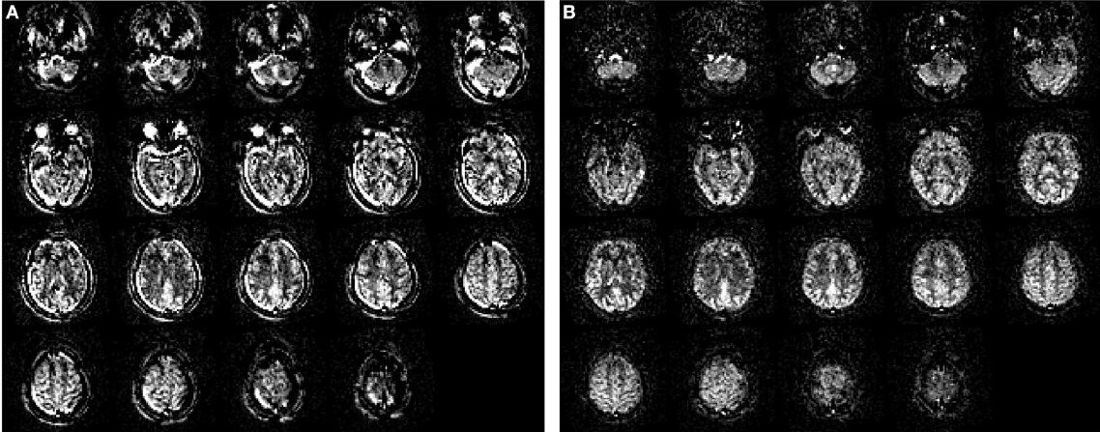
Single-Subject ASL Processing
Pre Post
Pre-processing steps
motion correction
fairly critical since this is a subtraction technique
can be difficult with the low SNR raw images
M0 image or middle ASL timepoint used as reference
affine registration
normalised correlation as similarity metric
trilinear interpolation
outlier exclusion
remove images with excessive artefacts or other issues
note, in 3D acquisitions, there are fewer control-label pairs so no exclusion done
registration
registration of ASL difference image and structural image
use grey matter probability maps
cost function of mutual information
cubic b-spline interpolation
M0 processing
used for voxel-wise calibration and B1 correction

Slide 16
Single-Subject ASL Processing
CBF Image Quantification
calculated by subtracting the label from the control images
M0 used to quantify values in mL/100g/min
For 2D imaging, do slice time correction in addition to PLD time
With a single PLD, the delay needs to be longer than the arterial transit time (ATT). If not can get
macrovascular artefacts
signal voids
hematocrit levels can affect CBF estimation
can estimate blood T1 from the hematocrit value but usually quite noisy measure

Slide 17
One-compartment CBF model
assumes blood enters through artery and exchanges with the tissue immediately and fully
i.e. uses fast exchange between compartments
assumes that blood has stayed intravascular and decayed with a blood T1 ~1.65s (at 3T)
protons spend some time in blood and some time in tissue
blood T1 and tissue water T1 are not equal
assumes all blood in artery exchanges with tissue
only a portion does so

Slide 18
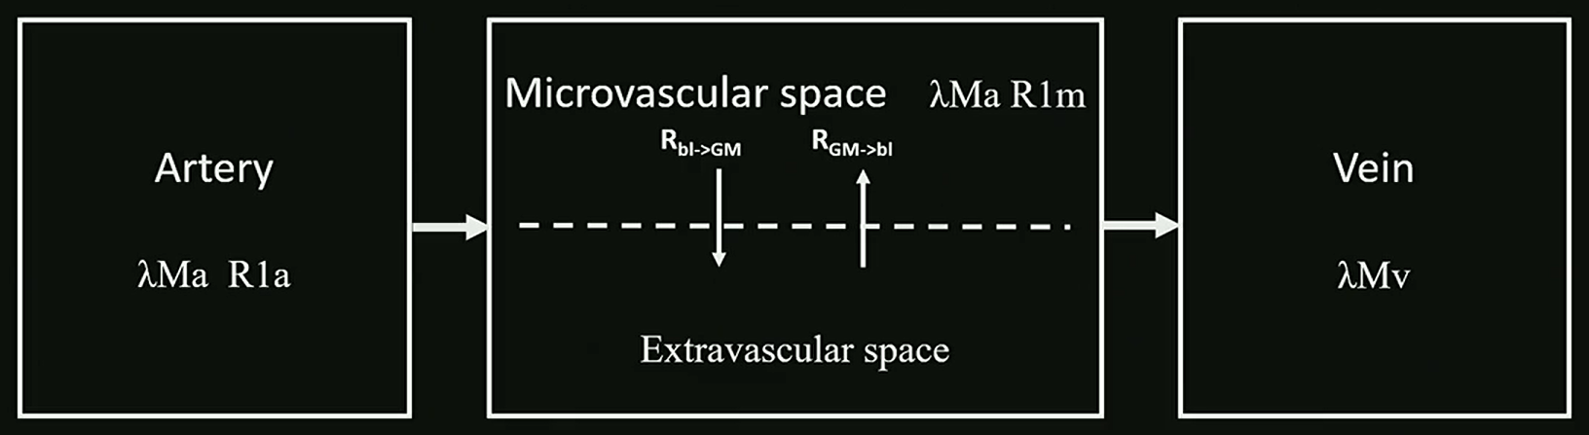
Two-compartment CBF model
accounts for signal from
intravascular water
extravascular water
exchange
New sequences such as diffusion-weighted or multi-echo time ASL can use this model to measure transport across BBB
Characterised with
Multi-TE PLD pCASL
A Paschoal. ISMRM 2023

Slide 19
Single-Subject ASL Processing
Partial Volume Correction
CBF in GM is 2-4X higher than WM
more of a problem because of ASL’s low spatial resolution (4x4x4mm³)
can lead to underestimation of GM CBF
estimate the GM CBF in each voxel by regressing out the GM and WM volumes from the CBF map

Slide 20
Group-Level Processing
create a template
create masks
excluded unwanted regions that may mess with the analysis
outside of brain
signal dropout from susceptibility
areas of vascular fluctuations
Multi-sequence equalisation
normalisation of CBF values over multi-site data
ROI statistics
usually includes whole brain, GM and specific ROIs of interest
make sure the region is large enough because of ASL’s low resolution

Slide 21
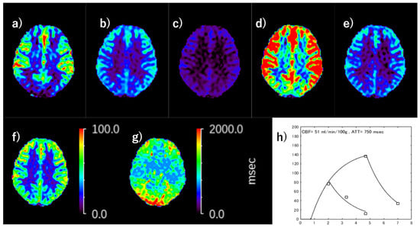
Outputs from ASL analysis
cerebral blood flow (CBF) map
bolus arrival time (BAT)
arterial transit time (ATT)
mean transit time (MTT)

Slide 22
ASL software packages
For a list of software visit https://osipi.github.io/task-force-1-1/
I’m going to go over a few of the more used ones
ASLPrep: A Robust Preprocessing Pipeline for ASL Data
BASIL: Bayesian Inference for Arterial Spin Labeling MRI
ASLtbx
ExploreASL

Slide 23
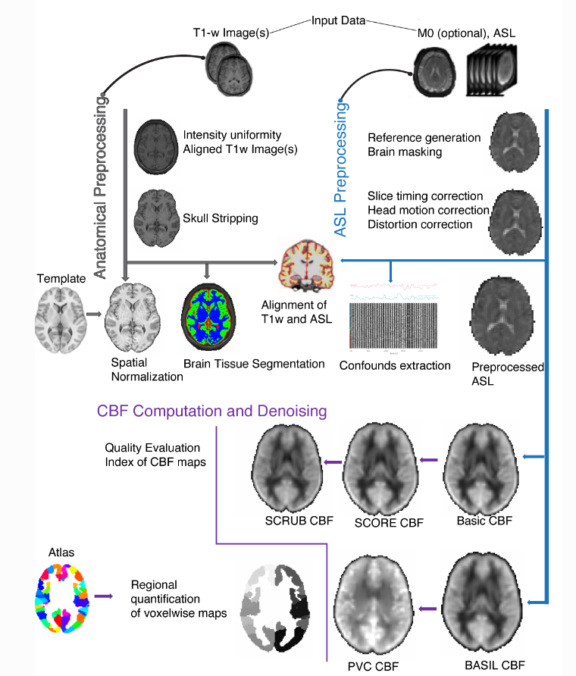
ASLPrep
developed by the Satterthwaite lab at the University of Pennsylvania
uses a combination of tools from well-known software packages, including FSL, ANTs, FreeSurfer and AFNI
Info found at https://aslprep.readthedocs.io/en/latest/
largely based on fMRIprep

Slide 24
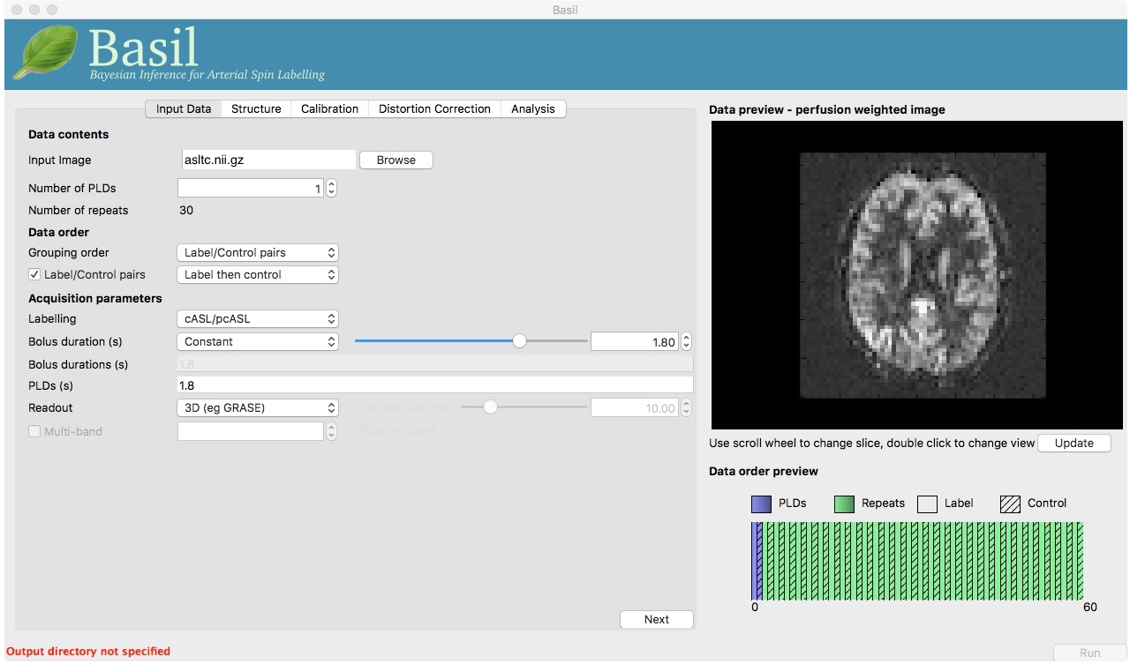
BASIL
Found in FSL toolbox (6.0.1)
Good for use in multi-PLD
For functional experiment with ASL data, i.e. one where you want to use a GLM, consult perfusion section of FEAT,
For dual-echo (combined BOLD and ASL) data, consult FABBER.
visit https://fsl.fmrib.ox.ac.uk/fsl/fslwiki/BASIL for details on what’s available and how to use

Slide 25
ASLtbx
https://www.cfn.upenn.edu/zewang/ASLtbx.php
can be used for both resting ASL data processing and ASL perfusion fMRI data processing
based in Matlab 5.3 and SPM 5/8/12
Looks like it hasn’t been updated since 2015.

Slide 26
ExploreASL
aim was to develop a comprehensive pipeline for reproducible multi-centre ASL analysis
part of NITRC neuroimaging pipelines https://www.nitrc.org/projects/exploreasl/
can be installed as a docker package or can be used within Matlab
code found at https://github.com/ExploreASL/ExploreASL/
description of the pipeline and code is in this paper
https://doi.org/10.1016/j.neuroimage.2020.117031
uses MATLAB and SPM12

Slide 27
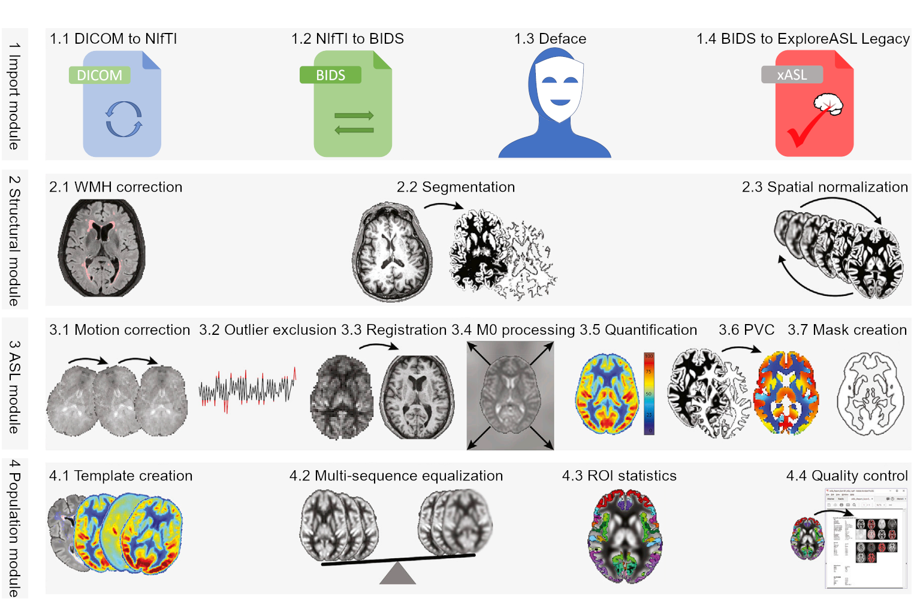
ExploreASL

Slide 28
Next Meeting
When: Wed Apr 3rd, 3:15-4:15
Where: CBH 3502 or zoom
Topic: Magnetisation Transfer

